Slide 1
CUSTOMIZED SES FOR PRODUCT MONITORING USING AIoT
PROJECT GUIDE:
Dr.M.BHUVANESWARI
TEAM MEMBERS:
Mr.G.THAMODHARAN – 810020106088
Mr. M BALAJI – 810020106302
Mr.K AKASH – 810020106306
Section: ‘B’

Slide 2
OBJECTIVE
To Implement RFid tags and face reconigition to accurately track product entry and exit from premises, ensuring reliable monitoring records.[ Monitoring]
To Design a user-friendly interface for easy system operation and monitoring by administrative staff.[User-Friendly Interface]
To Aim for at least a 95% accuracy rate in product monitoring, measured through comparative analysis of manual and automated mopnitoring records.[Accuracy Improvement]
To Integrate RFid and face recognition systems seamless to provide a comprehensive product monitoring solution.[System Integration]

Slide 3
BASE PAPER
Ishaq, Kashif, and Samra Bibi. "IoT based smart attendance system using RFID: A systematic literature review." arXiv preprint arXiv:2308.02591 (2023).

Slide 4
INTRODUCTION
Traditional methods of product monitoring often rely on manual processes, such as roll calls or sign-in sheets, which can be time-consuming and prone to errors. To address these challenges, modern technologies such as RFid and face recognition have been increasingly integrated into product monitoring systems.This allows for automated tracking of product entry and exit times.By combining RFid-based techniques with face recognition, product monitoring systems can achieve a higher level of accuracy and efficiency. This integration not only simplifies the product tracking process but also enhances security by ensuring that only authorized individuals are granted access to the premises.

Slide 5
LITERATURE SURVEY
No | Paper/book title | Authors | Findings
1 | Sensors-enabledSmart AttendanceSystems Using NFC and RFIDTechnologies(Februar y 2015International Journal of NewComputer Architectures and theirApplications 5(1):19-28 DOI:10.17781/P001645) | Cheah BoonChew,ManmeetMahinderjit-Singh,Kam Chiang Wei,Tan Wei Sheng,Mohd Heikal Husin, Nurul HashimahAhamed HassainMalim | Two innovations, principally the NFC and RFIDare utilized. Structures andusefulness of the twoinnovations are examined topto bottom.
2 | Web BasedStaffManagementSystem(International Journal ofScience Technology &Engineering | Volume 3 |Issue 09 | March 2017) | Ms. SayaliPramodDalke, Ms.Shruti AnilDeshmukh,Ms. JanabaiGovindDalave, Ms.Vaishnavi Nitin Sasane,Mrs. Pooja Kdhule | In this Proposed framework, The computerizedstaff management system it will assist the officewith dealing with their staff both quantitativelyand subjectively.
3 | Android, and QR code. “Automated Attendance System | H. Sutar, S. Chaudhari, P. Bhopi, and D. Sonavale, “Automated Attendance System,” Int. Res. J. Mod. Eng. Technol. Sci., vol. 04, no. 04, 2022. | Propose a system by generating a QR code for each lecture and scanning it for marking [11]

Slide 6
No | Tittle | Authors | Finding
4 | IoT, NVIDIA Jetson Nano, and Face Recognition , “Face Recognition Based Attendance System Using Jetson Nano,” | B. Chandramouli, S. A. Kumar, C. V. Lakshmi, G. B. Harish, and P. A. Khan, Int. Res. J. Mod. Eng. Technol. Sci., vol. 3, no. 8, 2021. | Faces are identified by the Haar classifier, then recognized by LBPH Algorithm, the histogram is checked against the dataset and marks attendance [13].
5 | Android, Authorized Username/Password, Android-based Smart Student Attendance System,” , and Web Server | M. A. J. Hameed, “Android-based Smart Student Attendance System,” Int. Res. J. Eng. Technol., vol. 12, pp. 2356–2395, 2017. | The three roles of the system are the admin can change the database, the instructor can mark students as present, and the reporter can verify attendance records and report all duties [].
6 | Android, GPS, and Face , “Mobile Based Attendance System: Face Recognition and Location Detection using Machine Learning,” in 2021 IEEE 12th Control and System | M. S. M. Alburaiki, G. M. Johar, R. A. A. Helmi, and M. H. Alkawaz, in 2021 IEEE 12th Control and System Graduate Research Colloquium, ICSGRC 2021 - Proceedings, 2021, | Lecturers generate class attendance and students mark their selves by scanning their faces along with their location [8].

Slide 7
.
No | Tittle\ | Authors | Finding
7 | Android, RFID, and Email Server , “Automated Attendance Marking and Management System by Facial Recognition Using Histogram,” . | J. D. W. S. Souza, S. Jothi, and A. Chandrasekar, in 2019 5th International Conference on Advanced Computing and Communication Systems, ICACCS 2019, 2019, doi: 10.1109/ICACCS.2019.8728399. | RFID is used for documenting student engagement at the back end. The application is intended to give families the attendance information [15].
8 | IoT, Face Recognition, and Email, “Face Recognition based Attendance Management System., | P. S. H. Smitha, “Face Recognition based Attendance Management System.,” Int. J. Eng. Res. & Technol., vol. 9, no. 05, 2020. | At each class, faces will be detected from a live video of the classroom and will mark attendance [6]
9 | Android, and Face , “Lecturer Attendance System using Face Recognition Application an Android-Based,” J. Comput. Networks, Archit. | F. Susanto, F. Fauziah, and A. Andrianingsih, J. Comput. Networks, Archit. High Perform. Comput., vol. 3, no. 2, pp. 167– 173, 2021, doi: 10.47709/cnahpc.v3i2.981. | Developing an Android app through speed detection using OpenCV. The LBPH Histogram will be embedded in facial detection [21].

Slide 8
METRICS TO BE MEASURED
Qualitative | Quantitative
The system aims to improve monitoring accuracy and efficiency, reducing instances and enhancing overall security. | The system targets at least a 95% accuracy rate in product monitoring, measured through comparative analysis of manual and automated records. The integration of RFid and face recognition technologies offers a comprehensive solution for product monitoring, traditional systems and providing a more reliable and secure method for product monitoring and identity verification.

Slide 9
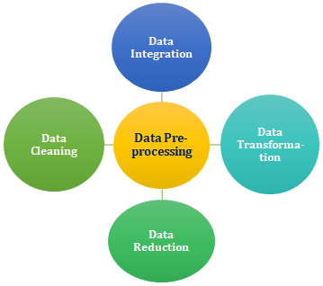
PREPROCESSING
Preprocessing in face recognition involves a series of steps to enhance the quality and usability of facial images before they are analyzed by the recognition algorithm. This typically includes tasks such as image resizing, normalization, and alignment to ensure consistency in facial features across different images.

Slide 10
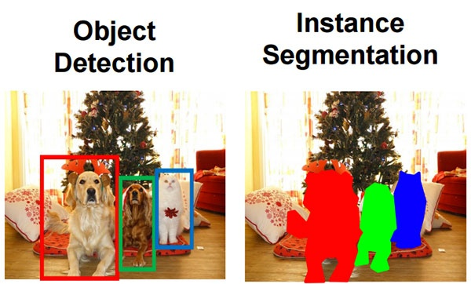
SEGMENTATION
Segmentation using face recognition involves the process of identifying and isolating individual faces within an image or video frame. This technique utilizes advanced algorithms to detect facial features such as eyes, nose, and mouth, allowing for accurate delineation of facial boundaries.

Slide 11
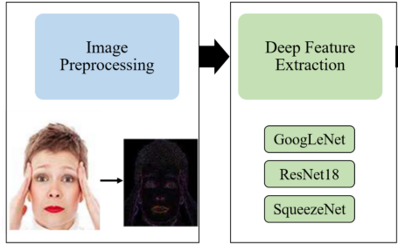
FEATURE EXTRACTION
Feature extraction in face recognition involves identifying and extracting distinctive characteristics or patterns from facial images to create a compact and representative feature vector. These features capture unique aspects of a person's face, such as the arrangement of eyes, nose, and mouth, as well as finer details like texture and shape.

Slide 12
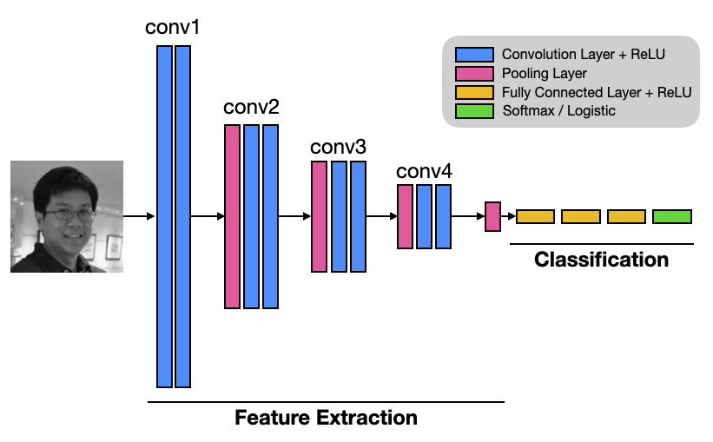
CLASSIFICATION
Classification using face recognition involves the identification and categorization of individuals based on their facial features. This process begins with capturing an image or video frame containing one or more faces, which is then analyzed using computer vision algorithms to extract facial features such as the eyes, nose, and mouth

Slide 13
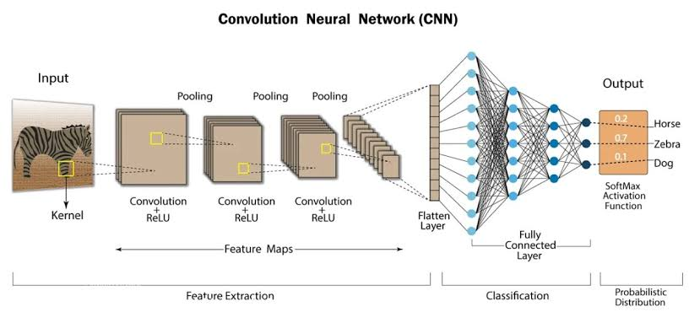
.

Slide 14
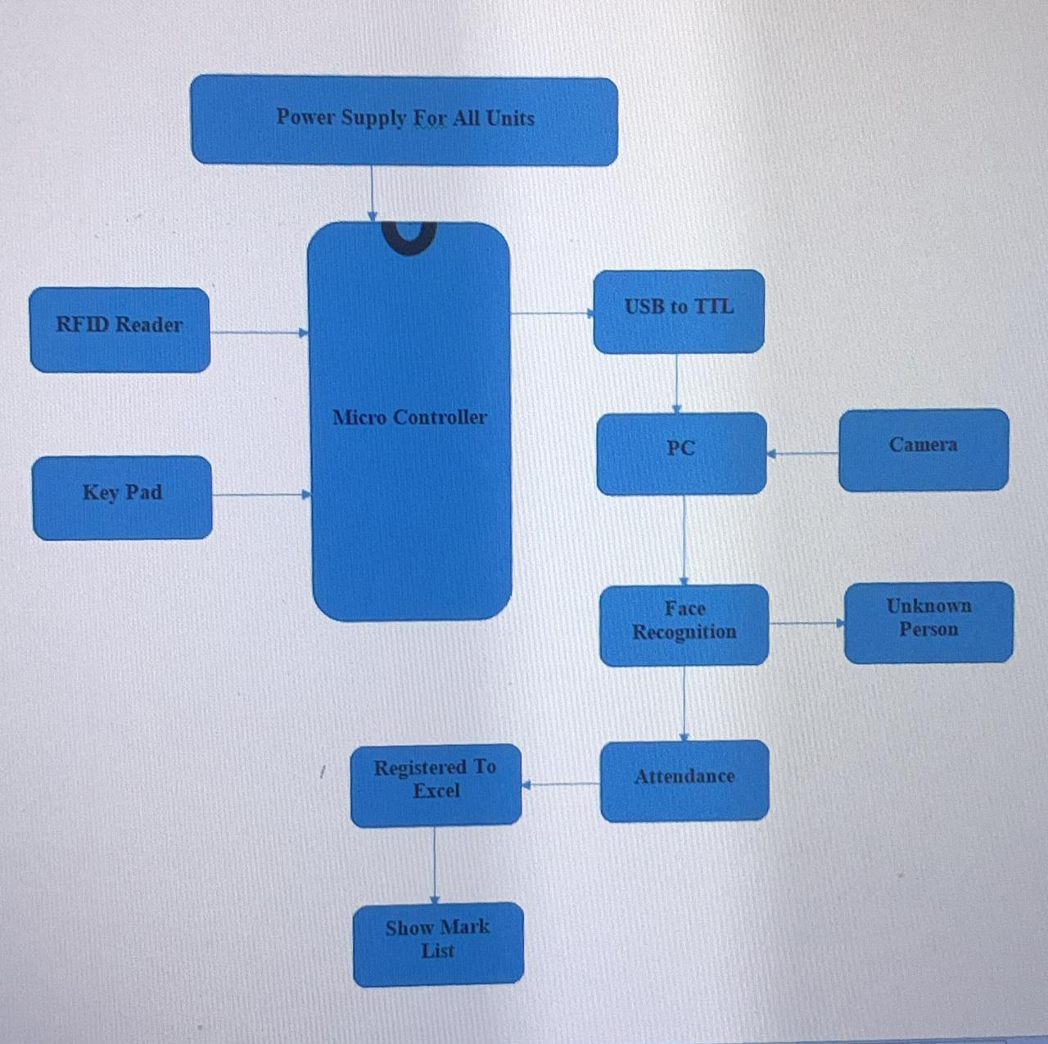
BLOCK DIAGRAM

Slide 15
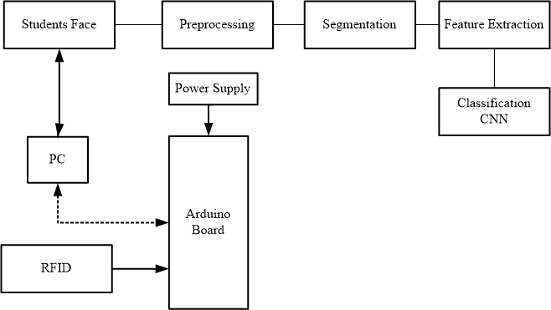
SUB-BLOCK DIAGRAM-1

Slide 16
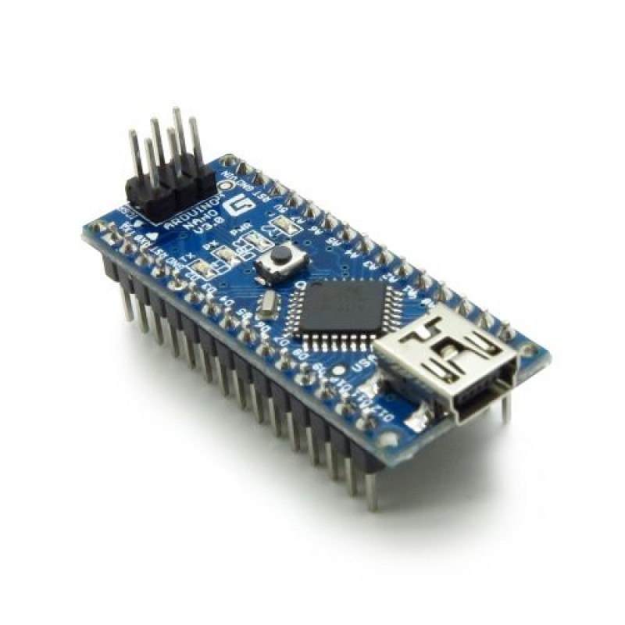
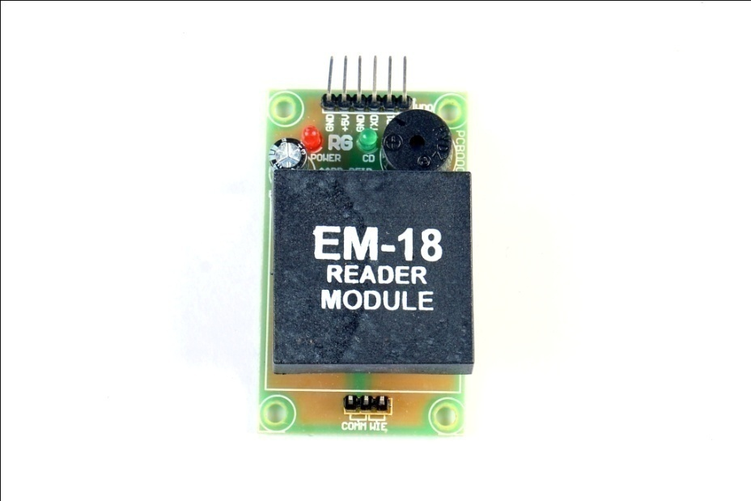
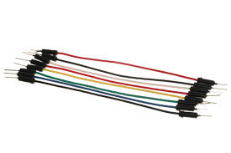
COMPONENTS
Arduino nano
Rfid reader module
wires

Slide 17
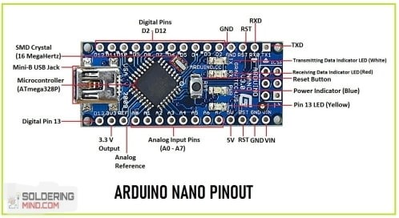
ARDUINO NANO PINOUT

Slide 18
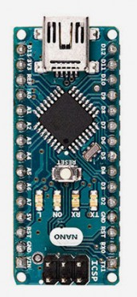
ARDUINO NANO
Arduino is an open source platform for prototyping based on user-friendly software.
It provides a flexible base for engineers to experiment on designing interactive environments.
Its main components are
14 digital input/output pins ( 6 can be used as PWM outputs)
6 analog inputs(can also be used for digital I/O - so a total of 20 digital I/O's)
16 MHz crystal oscillator
USB connection
reset button

Slide 19
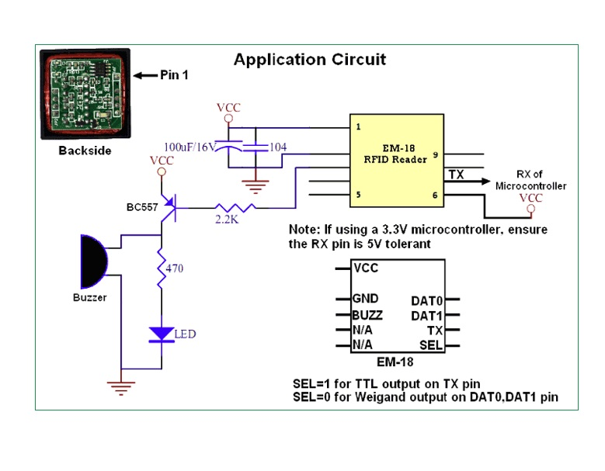
EM-18 MODULE

Slide 20
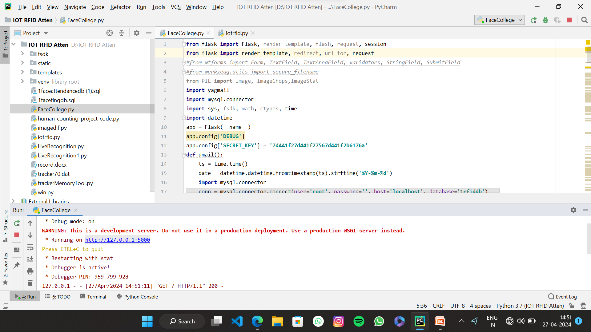
OUTCOME

Slide 21
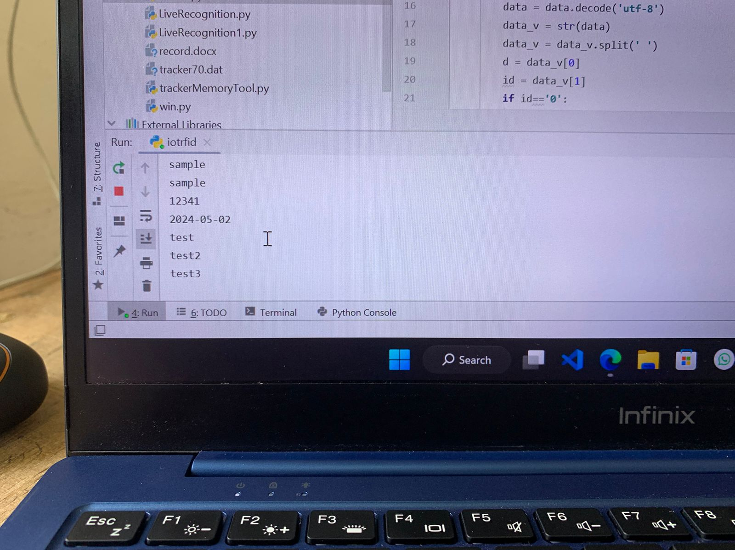

Slide 22
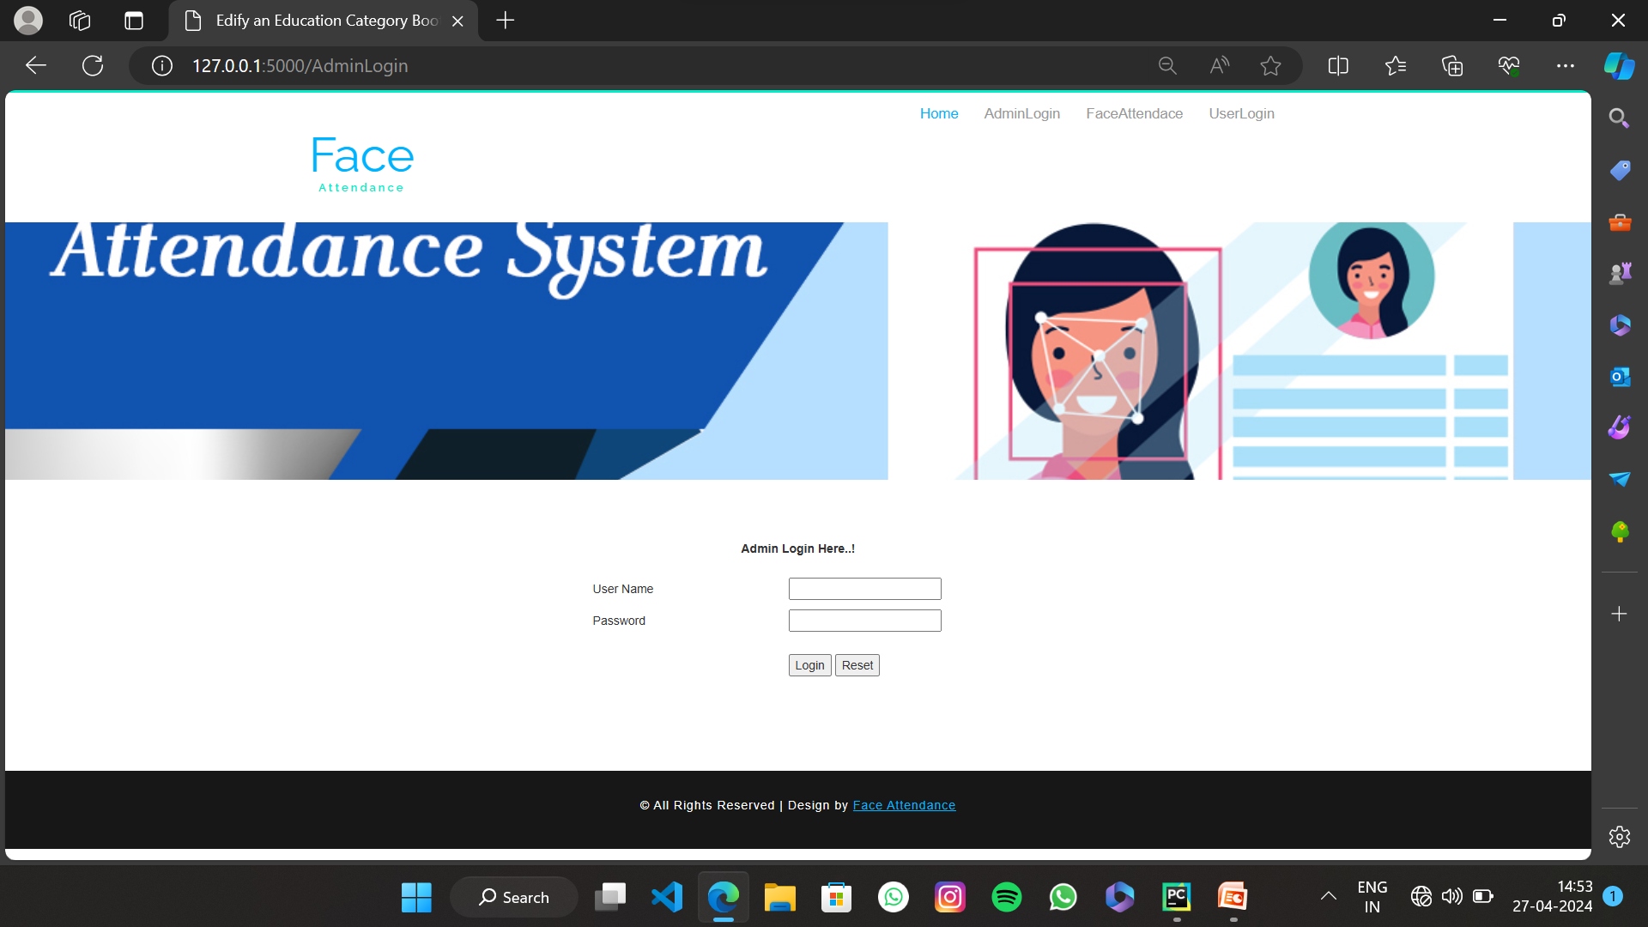

Slide 23
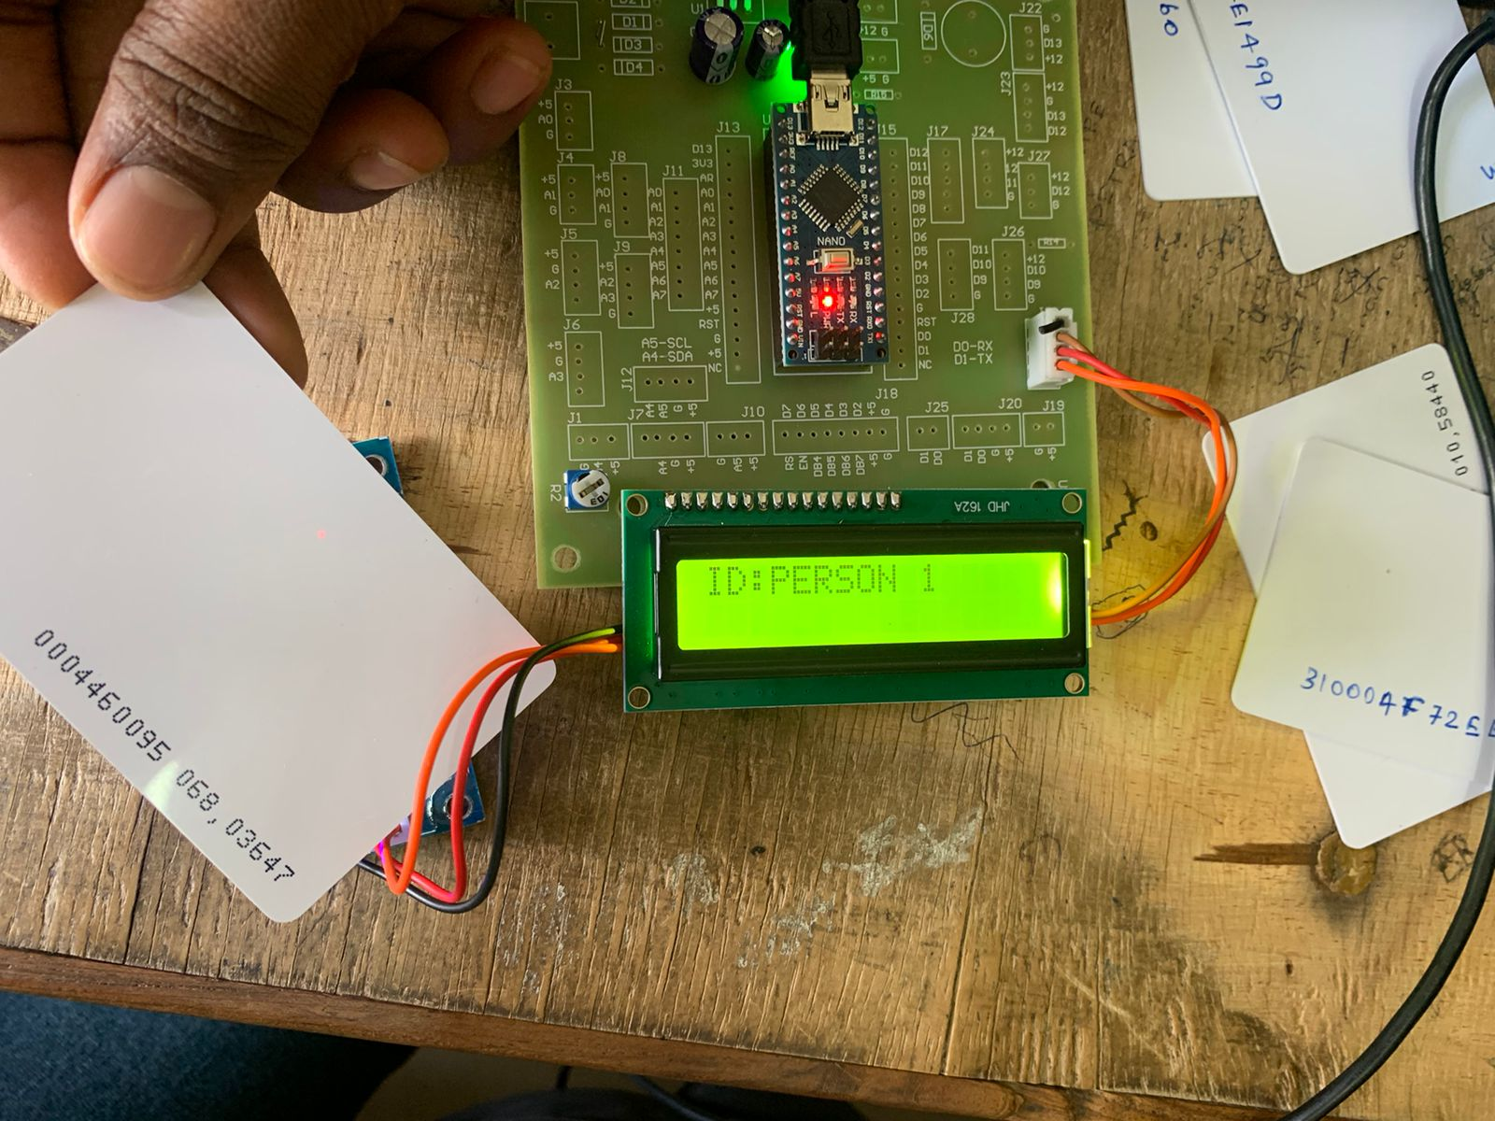
.

Slide 24
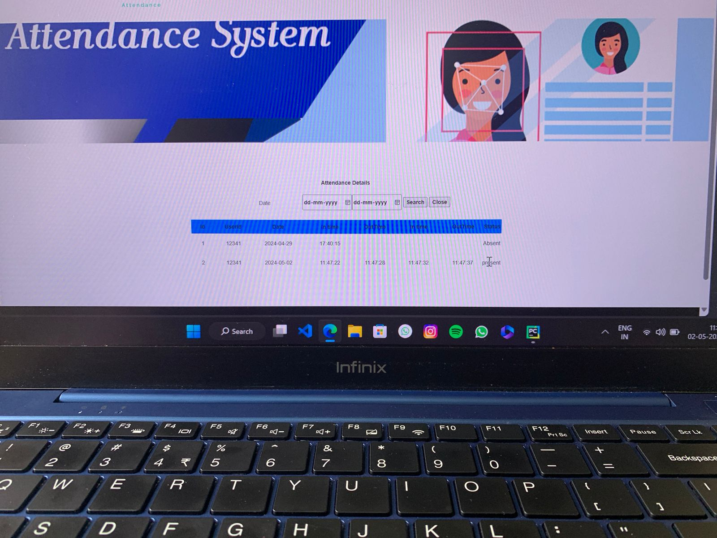
.

Slide 25
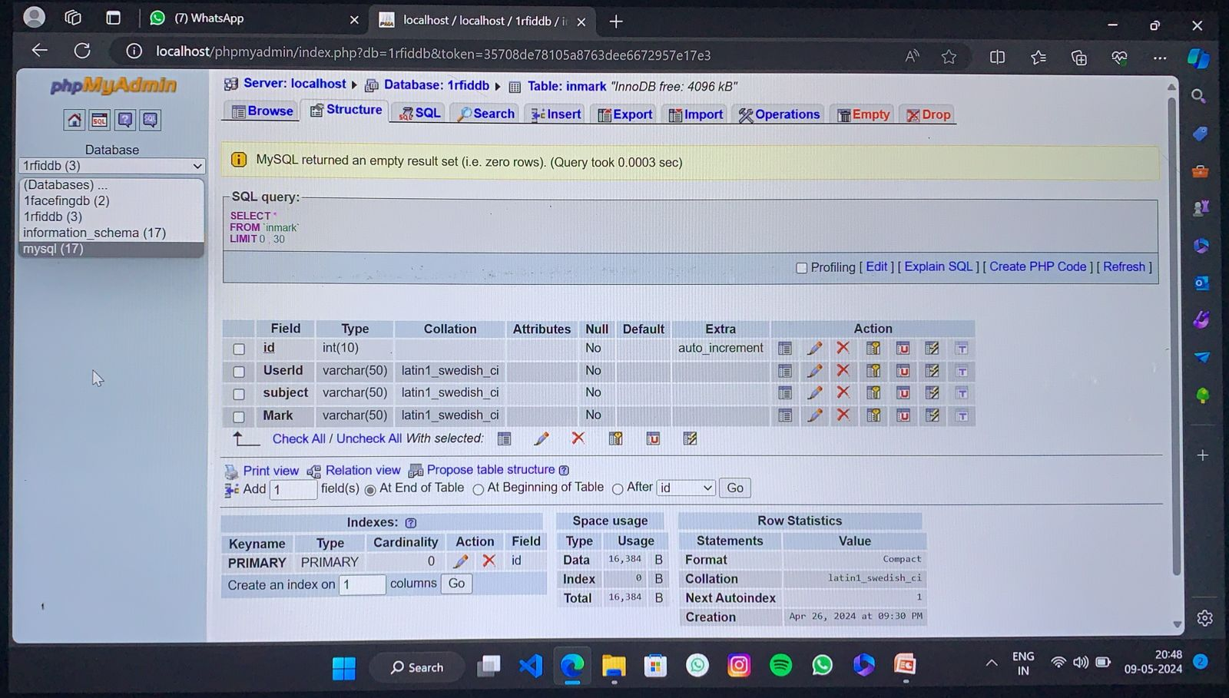
.

Slide 26
TOOLS
RFid reader Module,
Adurino Nano board,
Arduino IDE,
RFid tag,
Python IDE

Slide 27
OUTCOME
The implementation of the product monitoring System with AI represents a paradigm shift in the real of product tracking within educational institutions. By harnessing the combined power of RFID and facial recognition technologies, this system has transcended traditional methods, offering a streamlined and efficient approach to recording product monitoring.
Through the integration of RFID tags and facial recognition capabilities, products now have the convenience of simply presenting their RFID cards or having their faces scanned to register their presence in field, eliminating the need for manual product monitoring.

Slide 28
REFERENCES
D Sloan, H Manns, A Mellor and M. Jeffries, "Factors influencing student non-attendance at formal teaching sessions", Studies in Higher Education, vol. 45, no. 11, pp. 2203-16, November 2020.
S. Biichele, "Evaluating the link between attendance and performance in higher education: the role of classroom engagement dimensions", Assessment & Evaluation in Higher Education, vol. 46, no. 1, pp. 132-50, January 2021.
S. Welsen, "Impact of Blended Learning on Engineering Student Attendance Post COVID-19", 202l World Engineering Education Forum/Global Engineering Deans Council (WEEF/GEDC), pp. 88-94, November 2021.
A. U. Naik and N. Guinde, "LBPH Algorithm for Frontal and Side Profile Face Recognition on GPU", 2020 Third International Conference on Smart Systems and Inventive Technology (ICSSIT), pp. 776-779, 2020.
Partha Chakraborty, Chowdhury Shahriar Muzammel, Mahmuda Khatun, Sk. Fahmida Islam and Saifur Rahman, "Automatic Student Attendance System using Face Recognition", International Journal of Engineering and Advanced Technology (IJEAT), pp. 2249-8958, February 2020.

Slide 29
.
L. Li, Q. Zhang, X. Wang, J. Zhang, T. Wang, T.-L. Gao, W. Duan, K. K.-F. Tsoi, and F.-Y. Wang, ``Characterizing the propagation of situational information in social media during COVID-19 epidemic: A case study on Weibo,'‘ IEEE Trans. Comput. Social Syst., vol. 7, no. 2, pp. 556-562, Apr. 2020.
P. Sahu, ``Closure of universities due to coronavirus disease 2019 (COVID-19): Impact on education and mental health of students and academic staff,'‘ Cureus, vol. 12, no. 4, p. 7541, Apr. 2020.
N. Iivari, S. Sharma, and L. Ventä-Olkkonen, ``Digital transformation of everyday life How COVID-19 pandemic transformed the basic education of the young generation and why information management research should care?'‘ Int. J. Inf. Manage., vol. 55, pp. 1-6, Dec. 2020.
J. B. Arbaugh, `` classroom versus physical classroom: An exploratory study of class discussion patterns and student learning in an asynchronous Internet-based MBA course,'' J. Manage. Educ., vol. 24, no. 2, pp. 213-233, Apr. 2000.
K. Aravindhan,S.K.B.Sangeetha,K.Periyakaruppan, K.P.Keerthana, V.SanjayGiridhar and V.Shamaladevi, "Design of Attendance Monitoring System using RFID " 7th International Conference on Advanced Computing and Communication Systems (ICACCS), 2021, pp. 1628-1631, doi: 10.1109/ICACCS51430.2021.9441704.
G Poorni, K Balaji, C DeepthiNivetha, A personalized e-learning recommender system using the concept of fuzzy tree matching in International journal of advanced research in computer engineering and technology, Volume 4, Issue 11 (2015).

Slide 30
.
K.Aravindhan, B.Evangeline Prasanna, “A Cluster Approach in VANET Using Collaborative Learning Automata - Based Routing” in Asian Journal of Information Technology, Volume 15, No.21 (2016) ISSN: 1993-5994 (Online) Page No: 4269-4275.
J. T. Wu, K. Leung, and G. M. Leung, ``Nowcasting and forecasting the potential domestic and international spread of the 2019-nCoV outbreak originating in Wuhan, China: A modeling study,'' Lancet, vol. 395, no. 10225, pp. 689-697, Feb. 2020.
T. Alamo, D. G. Reina, M. Mammarella, and A. Abella, ``Covid-19: Opendata resources for monitoring, modeling, and forecasting the epidemic,'' Electronics, vol. 9, no. 5, pp. 1-30, 2020.
C. Rapanta, L. Botturi, P. Goodyear, L. Guàrdia, and M. Koole, ``Online university teaching during and after the Covid-19 crisis: Refocusing teacher presence and learning activity,'' Postdigital Sci. Educ., vol. 2, no. 3, pp. 923-945, Oct. 2020.
Y. K. Dwivedi, D. L. Hughes, C. Coombs, I. Constantiou, Y. Duan, J. S. Edwards, B. Gupta, B. Lal, S. Misra, P. Prashant, R. Raman, N. P. Rana, S. K. Sharma, and N. Upadhyay, ``Impact of COVID-19 pandemic on information management research and practice: Transforming education, work and life,'' Int. J. Inf. Manage., vol. 55, Dec. 2020, Art. no. 102211.
M. H. Shehata, E. Abouzeid, N. F. Wasfy, A. Abdelaziz, R. L. Wells, and S. A. Ahmed, ``Medical education adaptations post COVID-19: An Egyptian reflection,'' J. Med. Educ. Curricular Develop., vol. 7, pp. 1-9, Aug. 2020.
R. H. Huang, D. J. Liu, A. Tlili, J. F. Yang, and H. H. Wang, Handbook on Facilitating Flexible Learning During Educational Disruption: The Chinese Experience in Maintaining Undisrupted Learning in COVID-19 Outbreak. Beijing, China: Smart Learning Institute of Beijing Normal Univ., 2020.
W. Bao, ``COVID-19 and online teaching in higher education: A case study of Peking University,'' Human Behav. Emerg. Technol., vol. 2, no. 2, pp. 113-115, Apr. 2020.
J. Crawford, K. Butler-Henderson, J. Rudolph, B. Malkawi, M. Glowatz, R. Burton, P. Magni, and S. Lam, ``COVID-19: 20 countries' higher education intra-period digital pedagogy responses,'' J. Appl. Learn. Teaching, vol. 3, no. 1, pp. 1-20, 2020.

Slide 31
THANK YOU..

